Slide 1
Transforming General Education to Ensure Meaning-Making
AAC&U General Education Pedagogy and Assessment Conference, February 22, 2020
Jacksonville, Florida
Timothy S. Brophy, Professor and Director of Institutional Assessment
Elayne Colón, Associate Scholar and Director of Assessment and Accreditation, College of Education
M. David Miller, Professor and Director, School of Human Development and Organizational Studies in Education
Andrew Wolpert, Associate Professor and Director of UF Quest

Slide 2
Our Premise
The greater danger for most of us lies not in setting our aim too high and falling short; but in setting our aim too low and achieving our mark.
-Michelangelo
Source: https://www.michelangelo.org/michelangelo-quotes.jsp

Slide 3
Overview
Introductions
Overview of General Education at the University of Florida
Why the need for change? SERU evidence of student perceptions of General Education
Introduce and overview UF Quest
Discussion
Overview of SLOs for UF Quest
Assessment Design for UF Quest
Discussion
Closing Summary

Slide 4
General Education Program Requirements
General Education
Subject Area | UF Core | State Core | Gen Ed Courses | Totals
Composition |  | 3 | 3 | 6
Humanities* | 3 | 3 |  | 6
Social & Behavioral Science* |  | 3 | 3 | 6
Mathematics |  | 3 | 3 | 6
Natural Science |  | 3 | 3 | 6
Additional Required Gen Ed Coursework (Humanities, Social Science, or Natural Science)** |  |  | 6 | 6
OVERALL TOTALS | 3 | 15 | 18 | 36

Slide 5
General Education Student Learning Outcomes
Category | Institutional Definition | Institutional SLO
Content | Content is knowledge of the terminology, concepts, methodologies and theories used within the subject area. | Students demonstrate competence in the terminology, concepts, methodologies and theories used within the subject area.
Critical Thinking | Critical thinking is characterized by the comprehensive analysis of issues, ideas, and evidence before accepting or formulating an opinion or conclusion. | Students carefully and logically analyze information from multiple perspectives and develop reasoned solutions to problems within the subject area.
Communication | Communication is the development and expression of ideas in written and oral forms. | Students clearly and effectively communicate knowledge, ideas, and reasoning in written or oral forms appropriate to the subject area.

Slide 6
2020-2022 General Education (GE) Assessment Plan
 | Spring 2020 | Summer 2020 | Fall 2020 | Spring 2021 | Summer 2021 | Fall 2021 | Spring 2022
 |  |  | UF Quest 1 Implemented |  |  | UF Quest 2 Implemented
Subject Areas
Composition | GE | GE | GE | GE | GE | GE | GE
Humanities | GE | GE | UF Quest | UF Quest | UF Quest | UF Quest | UF Quest
Mathematics | GE | GE | GE | GE | GE | GE | GE
Physical and biological Sciences | GE | GE | GE | GE | GE | UF Quest | UF Quest
Social and Behavioral Science | GE | GE | GE | GE | GE | UF Quest | UF Quest

Slide 7
Critical Thinking Rubric
 | OUTSTANDING | SATISFACTORY (TARGET) | UNSATISFACTORY
Explanation of Issues | Comprehensively identifies and summarizes main issues, explaining why they constitute problems or how they create questions: identifies embedded or implicit issues, addressing their relationship to each other | Identifies and summarizes the main issues, and explains why they constitute problems or create questions at an acceptable level that is not seriously impeded by omissions or errors | Identifies, summarizes and explains the main problem or questions at an unacceptable level. Represents the issues inaccurately or inadequately
Evidence/ Analysis | Uses high quality, credible, relevant sources to thoroughly and rigorously investigate the subject; logically analyzes alternate points of view, revealing important differences or similarities within the topic | Uses credible, relevant sources to question and analyze alternate points of view, revealing some differences or similarities within the topic at an acceptable level that is not seriously impeded by omissions or errors | Uses insufficient or irrelevant sources or evidence to support ideas; formulates and expresses a point of view that does not consider the evidence and data when forming judgments
Conclusion | Comprehensively discusses implications and conclusions considering all relevant data and evidence. A clear and precise point of view and appropriate conclusion are formulated and presented | Discusses implications and conclusions, considering relevant data and evidence at an acceptable level that is not seriously impeded by omissions or errors. A credible point of view or conclusion is presented | Formulates and expresses a point of view that does not consider the evidence and data when forming judgments

Slide 8
Data Visualization (Tableau)
Sampling Courses
Summary using SLOs and Rubrics for
Courses
Subject Area
General Education
https://public.tableau.com/profile/uf.oipr4918#!/vizhome/GenEdCourses2/Dashboard1

Slide 9
Visualization of
Institutional Data
2017-2018

Slide 10
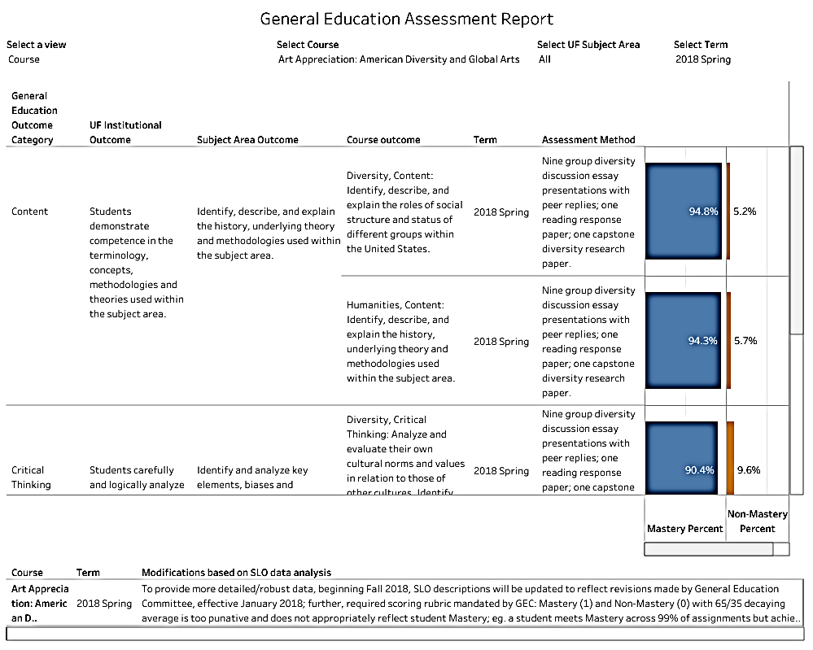
General Education
Course Level Data
Identify, evaluate and compare their own social status, opportunities, and constraints with those of other persons and groups.

Slide 11
Student Perceptions of General Education: SERU 2015 (N = 2,095)
Contribution of courses to your: | Percent responding Significantly or Extremely
 | Gen Ed courses | Other courses
Critical Thinking | 25 | 35
Clear and effective writing | 34 | 32
Appreciate, tolerate and understand racial and ethnic diversity | 36 | 26
Read and comprehend academic material | 32 | 28
Quantitative skills | 32 | 68
Speak clearly and effectively | 47 | 36
Understand international perspectives | 57 | 48
Appreciate fine arts | 33 | 40
Appreciate cultural and global diversity | 25 | 37

Slide 12
SERU 2017 (N = 1,465)
Contribution of courses to: | Percent responding Significantly or Extremely
 | Gen Ed | Other than Gen Ed
Your openness to understand and communicate with others who possess differing viewpoint to your own | 26 | 40
Your connection to a faculty mentor or community mentor | 16 | 16
A heightened awareness of the needs of others in the surrounding local Alachua County? | 22 | 30
Your knowledge of how multiple disciplines can work together to solve problems | 28 | 50
Confirming your choice of major | 21 | 63
Connecting your major to what you believe is your life's purpose | 19 | 50
Ability to participate fully and responsibly as an informed global citizen | 25 | 43
An increase in valuable skills, including oral and written communication and critical thinking | 35 | 57

Slide 13
Precursors to UF Quest
UF Task Force on Undergraduate Education (2010 Report)
Signature experience, e-Portfolio, experiential learning
UF Core (2012 Implementation)
“What is the Good Life” is required of all First-Time-in-College Students
Grand Challenges Core (2013 Proposal)
“What is the Good Life?” (Humanities)
“Challenge of Climate Change” (Biophysical Sciences)
“An Informed Life: People and Data” (Social and Behavioral Sciences)

Slide 14
UF Quest Task Force 2016-2017
Curricular reform driven by faculty expertise and student choice.
UF Quest needs to excite student interest in the subject areas, and not just be a box to check.
UF Quest elements need to be built into courses not just added on.
Required components
experiential learning, reflection, meaning making
rigorous and engaging
multi-disciplinary, sequential

Slide 15
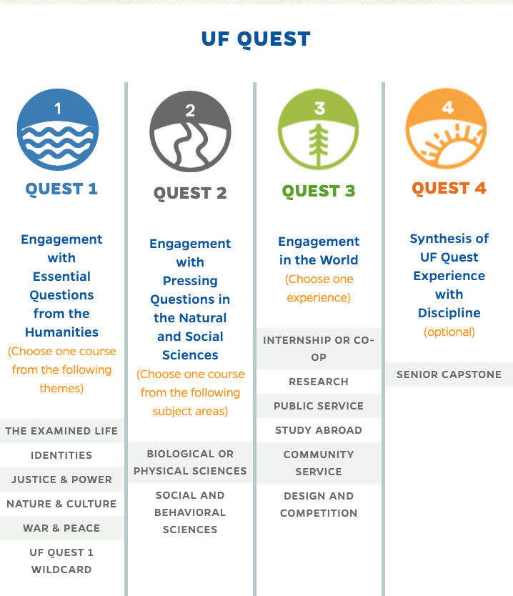
The UF Quest Program
3 credits
3 credits
0-3 credits
optional

Slide 16
Discussion
Share how you address general education at your institution.
To what extent does it include meaning and sense making?

Slide 17
UF QUEST Student Learning Outcomes
UF Quest 1: Engagement with Essential Questions from the Humanities
Gen Ed Category: Humanities | General Education Humanities SLO | UF Quest 1 SLO
Content | Identify, describe, and explain the history, underlying theory and methodologies used. | Identify, describe, and explain the history, theories, and methodologies used to examine essential questions about the human condition within and across the arts and humanities disciplines incorporated into the course.
Critical Thinking | Identify and analyze key elements, biases and influences that shape thought within the subject area. Approach issues and problems within the discipline from multiple perspectives. | Analyze and evaluate essential questions about the human condition using established practices appropriate for the arts and humanities disciplines incorporated into the course.
Communication | Communicate knowledge, thoughts and reasoning clearly and effectively. | Develop and present clear and effective responses to essential questions in oral and written forms as appropriate to the relevant humanities disciplines incorporated into the course.
Connection (Unique to UF Quest) | None. (Quest only). | Connect course content with critical reflection on their intellectual, personal, and professional development at UF and beyond.

Slide 18
UF QUEST Student Learning Outcomes
UF Quest 2: Engagement with Pressing Questions from the Natural and Social Sciences
Gen Ed Category: Physical and Social Sciences | General Education Social and Behavioral Sciences SLO | Quest 2 SLO (Physical and Social Sciences)
Content | Identify, describe, and explain key themes, principles, and terminology; the history, theory and/or methodologies used; and social institutions, structures and processes. | Identify, describe, and explain the cross-disciplinary dimensions of a pressing societal issue or challenge as represented by the social sciences and/or biophysical sciences incorporated into the course.
Critical Thinking | Apply formal and informal qualitative or quantitative analysis effectively to examine the processes and means by which individuals make personal and group decisions. Assess and analyze ethical perspectives in individual and societal decisions. | Critically analyze quantitative or qualitative data appropriate for informing an approach, policy, or praxis that addresses some dimension of an important societal issue or challenge.
Communication | Communicate knowledge, thoughts and reasoning clearly and effectively. | Develop and present, in terms accessible to an educated public, clear and effective responses to proposed approaches, policies, or practices that address important societal issues or challenges
Connection (Unique to UF Quest) | None. (Quest only). | Connect course content with critical reflection on their intellectual, personal, and professional development at UF and beyond.

Slide 19
The Assessment Plan for UF Quest
To follow this development, go to: https://assessment.aa.ufl.edu/assessment--accreditation-/academic-assessment/uf-quest-assessment-task-force/

Slide 20
Step 1: Convene a UF Quest Assessment Task Force The UF Quest Assessment Task Force is charged to develop the assessment plan for Quest, the University of Florida’s new general education signature experience.
UF Quest Assessment Task Force Members
First name | Last name | Department | College
Erik | Black | Pediatrics | Medicine
Shaun | Boren | Director, Assessment and Research | Division of Student Affairs
Elayne | Colon | Assessment and Accreditation | Education
Laura | Ellis | School of Music | Arts
Robyn | Goodman | Advertising | Journalism and Communications
George | Hack | Occupational Therapy; Instructional Design | Public Health and Health Professions
Allyson | Haskell | Instructional Design | Center for Instructional Technology and Training
Kryriaki | Kaplanidou | Sport Management | Health and Human Performance
Swapna | Kumar | Educational Technology | Education
Corinne | Manley | Research and Evaluation Methodology | Education
John | Mendoza Garcia | Engineering Education | Herbert Wertheim College of Engineering
David | Miller | School of Human Development and Organizational Studies | Education
Joann | Mossa | Geography | Liberal Arts and Sciences
Richard | Nolan | Political Science | Liberal Arts and Sciences
Karen | Reed | Biobehavioral Nursing Science | Nursing
Robert | Ries | Building Construction | Design, Construction, and Planning
Amy | Simonne | Food Scientist | Agricultural and Life Sciences
Laura | Spears | Director of Assessment | George A. Smathers Libraries
Aaron | Thomas | Principal Analytics and Evaluation Analyst | Pharmacy
Andrew | Wolpert | Director, UF Quest | Liberal Arts and Sciences

Slide 21
Step 2: Develop a Glossary
We often overlook the fact that we convene with different definitions of critical terms to be used throughout the process.
Your handout presents the glossary we are using.

Slide 22
Step 3: How can we know that students have met the outcomes?
Presentation – a speech or a talk in which a new product, idea, or piece of work is shown and explained to an audience.
Paper – a written work of specified length on a topic, in one of several forms, i.e. research paper, essay, an article, etc.
Project – a planned undertaking; in the academy, usually in the form of a a response to a task or problem engaged in by students.
Production/Performance – a literary or artistic work (music, dance, drama, visual art, media), presented or exhibited to the public on stage, screen or over the air or virtually in a digital space.
Reflection – a written statement arising from serious thought or consideration given to the examination and exploration of how the writer has changed, developed, or grown from experience or interaction with some subject matter, idea, or purpose.

Slide 23
Step 4: What are the essential rubric criteria and achievement levels for each of the five assignment types?
We use four levels of achievement (4, 3, 2, 1)
3 = our target level of expectation
Rubrics are still in development but will be published upon completion

Slide 24
Step 5. Collection and Analysis of Data
We are seeking a “digital place” to facilitate this work – perhaps a portfolio
We are discussing various approaches to this

Slide 25
Discussion
What innovative assessment designs and high impact practices are you currently engaging to assess student learning in general education?
What forms might a ‘digital place’ for student learning assessment of meaning and sense-making take beyond the ePortfolio?

Slide 26
Summary
Our Challenges: Size, comprehensive nature of our institution
Faculty involvement by representation
Communication and Dissemination
Sequential planning for assessment is necessary

Slide 27
Closing
Change
moves at the speed of
Trust

