Slide 1


Closing the Assessment Loop with AI and Learning Analytics Aaron Thomas, PhD, Principal Data Scientist and Associate In Data Platform and Analytics UFIT
April 16, 2025

Slide 2
Assessment Landscape
Institutional
College
Faculty
Department

Slide 3
NaviGator Analytics
Learning Analytics and Rubric Data Access
Student Evaluations and LLM integration
Academic Performance Analytics

Slide 4
First Principles
Data Security-HITRUST compliant storage
Data privacy through official registrar role-based access
Data governance
Primum noli nocere

Slide 5

History of Project
Institutional Student
Success:
Grades other
than C-,D,E, W
Instructional Student Success:
Measurable student mastery of specific learning objectives or tasks.

Slide 6
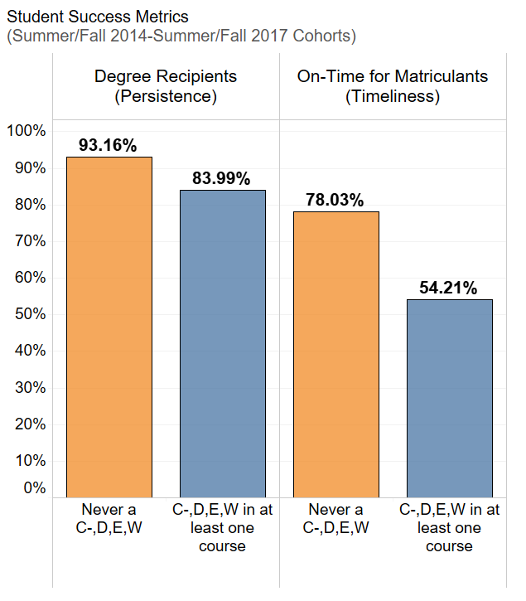
C-,D,E, W Grades & Student Success Metrics

Slide 7
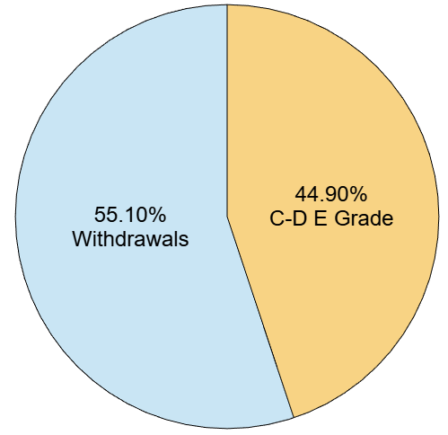
Withdrawals vs Non-Passing Grades
Distributions of non-passing grades vs withdrawals across gateway/core tracking courses (13,946 non-success enrollment)

Slide 8
Regulation of Teaching Practice
Academic Performance
Learning Analytics
Learning Outcomes
Instructor Tasks
(Design/Assessment/Culture)
Student Voice

Slide 9
Problem to solve
Provide an institutional lens of student data. Address missing data.
Instructor Canvas Data | Institutional Data
10% non-success | 22% non-success

Slide 10








Problem to solve
Develop a custom application that integrates multiple internal and external data sources most relevant to teaching and learning
Student Information System

Slide 11
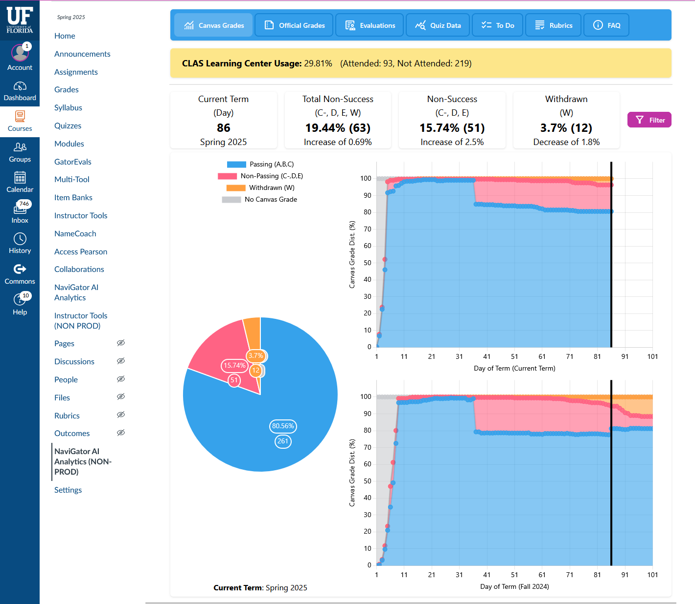
Trends
Current
Current and historical academic performance trends.
Historical

Slide 12
Trends
Current usage rates of on-campus tutorings services

Slide 13
Instructor Role in Destigmatization of Tutoring Services
All three instructors used same books, assessments, and labs
 | Faculty A: Frequently discusses and recommends tutoring during lecture (Human) | Faculty B: Allows the UF Predictive System to recommend tutoring when student is identified via Canvas emails (Machine Learning) | Faculty C: Control
% Students Passing Course | 84% | 73% | 75%
% of Predicted Non-Success Students using Tutoring | 64% | 26% | 30%
Covariates Evaluated: GPA rank within major, previous C-DEW, first or repeated attempt

Slide 14
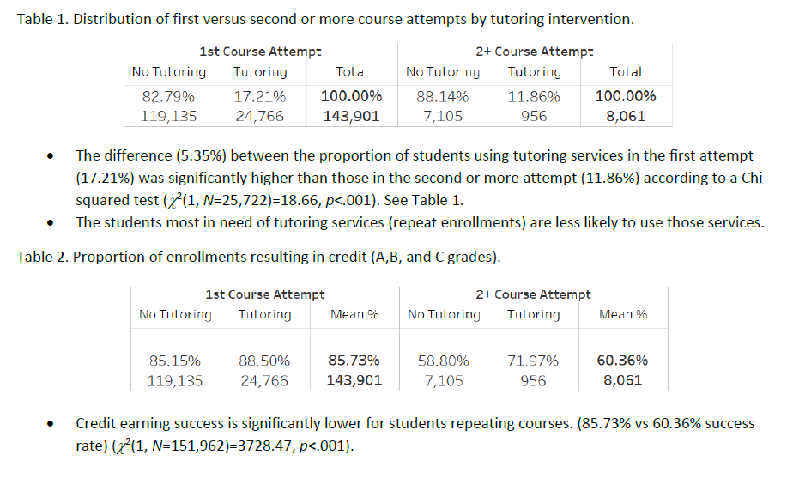
Tutoring at UF

Slide 15
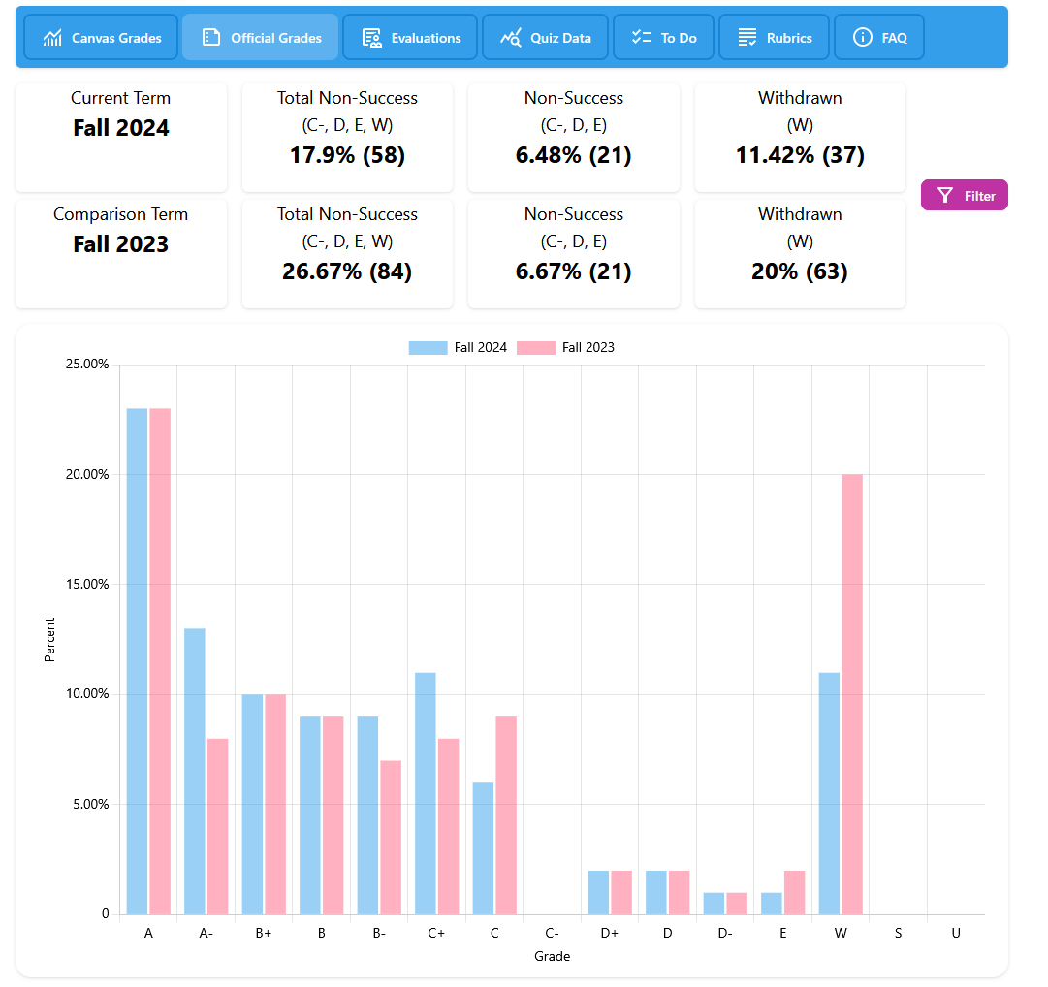
Official Grade Comparison

Slide 16
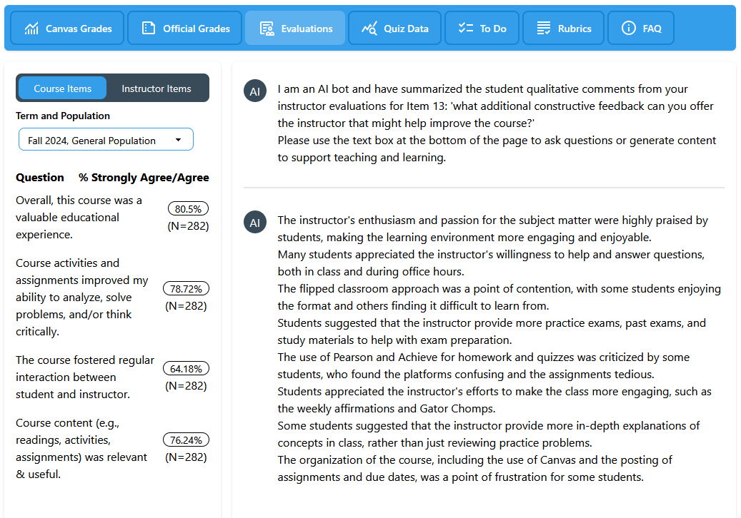
Student Voice

Slide 17
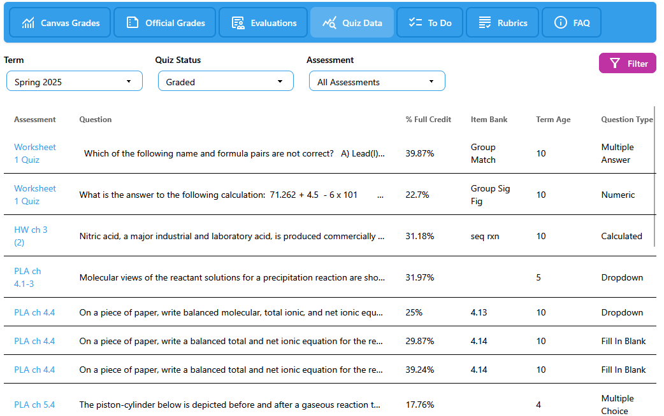
Quiz Analytics

Slide 18
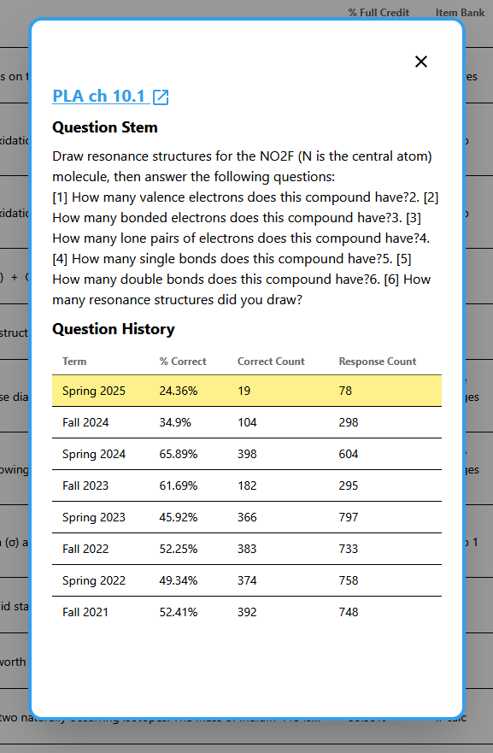
Quiz Analytics
Explain the concept of entropy.

Slide 19
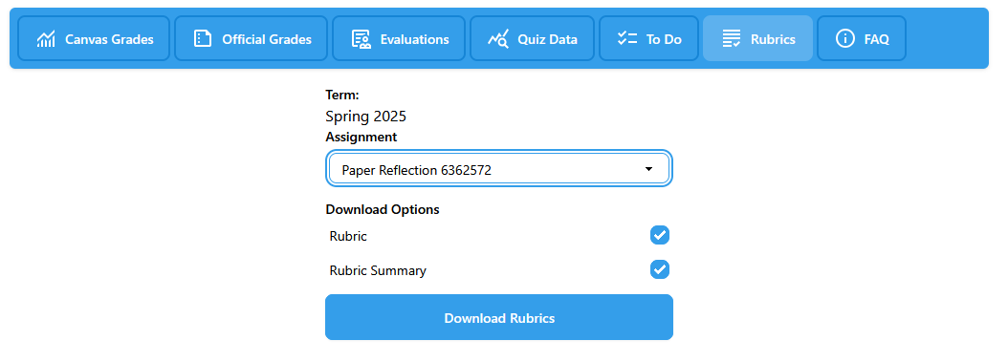
Rubric Row Level and Summary Data

Slide 20
Rubric Summary
CRITERION_CONCATENATED | RATING_SD | RATING_LD | RATING POSSIBLE POINTS | AVERAGE CRITERION SCORE BY RATING LEVEL | N STUDENTS AT RATING LEVEL | TOTAL STUDENTS | % N STUDENTS BY RATING LEVEL
ARGUMENT AND SUPPORT | Excellent | (+20) Materials from the semester support my articles and I show that they strengthen my argument. Reveals a high degree of critical thinking. | 20 | 17.8125 | 32 | 65 | 49.23%
ARGUMENT AND SUPPORT | Good | (+16) I used some materials to make my argument. They were present but didn’t entirely strengthen my argument. Critical thinking is weaved into points. | 16 | 17.8125 | 28 | 65 | 43.08%
ARGUMENT AND SUPPORT | Needs Improvement | (+13) I rarely mention the materials from the class. Some critical thinking is present. | 13 | 17.8125 | 4 | 65 | 6.15%
ARGUMENT AND SUPPORT | See your instructor | (+10) I didn’t mention any details or material from the semester. Ideas are vague with little evidence of critical thinking. | 10 | 17.8125 | 0 | 65 | 0.00%
CONTENT | Excellent | (+40) I had a clear focus that addressed the prompt, included numerous specific details, and made a point. I elaborated on the topic by including creative or unique details. | 40 | 38.32308 | 43 | 65 | 66.15%
CONTENT | Good | (+37) My text had a clear focus that addressed the prompt, included some appropriate details, and made a point. | 36 | 38.32308 | 15 | 65 | 23.08%
CONTENT | Needs Improvement | (+33) I stayed within the topic and my intentions were clear, but I didn’t include enough details to sufficiently address the prompt. I needed to include more details! | 33 | 38.32308 | 7 | 65 | 10.77%
CONTENT | See your instructor | (+25) I strayed from the topic or only addressed it superficially and/or did not include concrete details. My point in the text was not clear! | 25 | 38.32308 | 0 | 65 | 0.00%

Slide 21
Limitations
The tool is for credit-bearing courses only
Only official instructors have access to the tool
It is not possible for an instructor to grant access to any other UF person
Courses where there is no official instructor will have no data

Slide 22
Demo
Aaron Thomas, PhD
Principal Data Scientist and Associate In
UFIT
aothomas@ufl.edu or dpa-data-science@ad.ufl.edu

