Slide 1

Leveraging NaviGator AI for Enhancing Ethical Reflection in Dental Education
Ana Ribeiro, DDS, MS, PhD
Carrie Wells, EdD
College of Dentistry

Slide 2

Background
UF Dentistry students must demonstrate mastery of competency:
UFCD 5 - Ethical Standards: Apply principles of ethical decision making and professional responsibility.
Students receive 4 years of instruction in ethics in didactic, preclinical, & clinical courses
Summative assessment required students to reflect on an 'ethical dilemma' they experienced throughout their clinical years (D3 and D4)

Slide 3
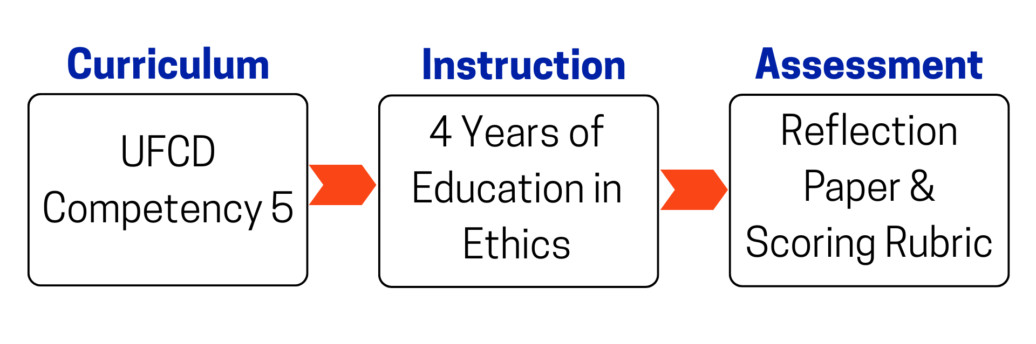
Rationale for Assessment

Slide 4
Problem
Students graduating from Professional Dentistry Program lack critical thinking skills to examine ethical dilemma to present on Ethics Day to American College of Dentistry Fellows
Historically, ethical dilemmas superficially identified, described, & explored
Assignment components (from project description to scoring rubric) may lack detail/alignment

Slide 5

Proposed Solution
NaviGator AI can guide students through self-reflection process to write papers
All other elements of project remained same to test effectiveness of using NaviGator AI as an interviewer

Slide 6
Method
Preset created with custom instructions in NaviGator AI using project description from previous year
AI prompted to engage in "interview" process, asking students questions about their ethical dilemma
Submission was two-part: copy of AI interview & traditional Ethics paper
Two independent scorers used rubric to score 2024 & 2025 submissions

Slide 7
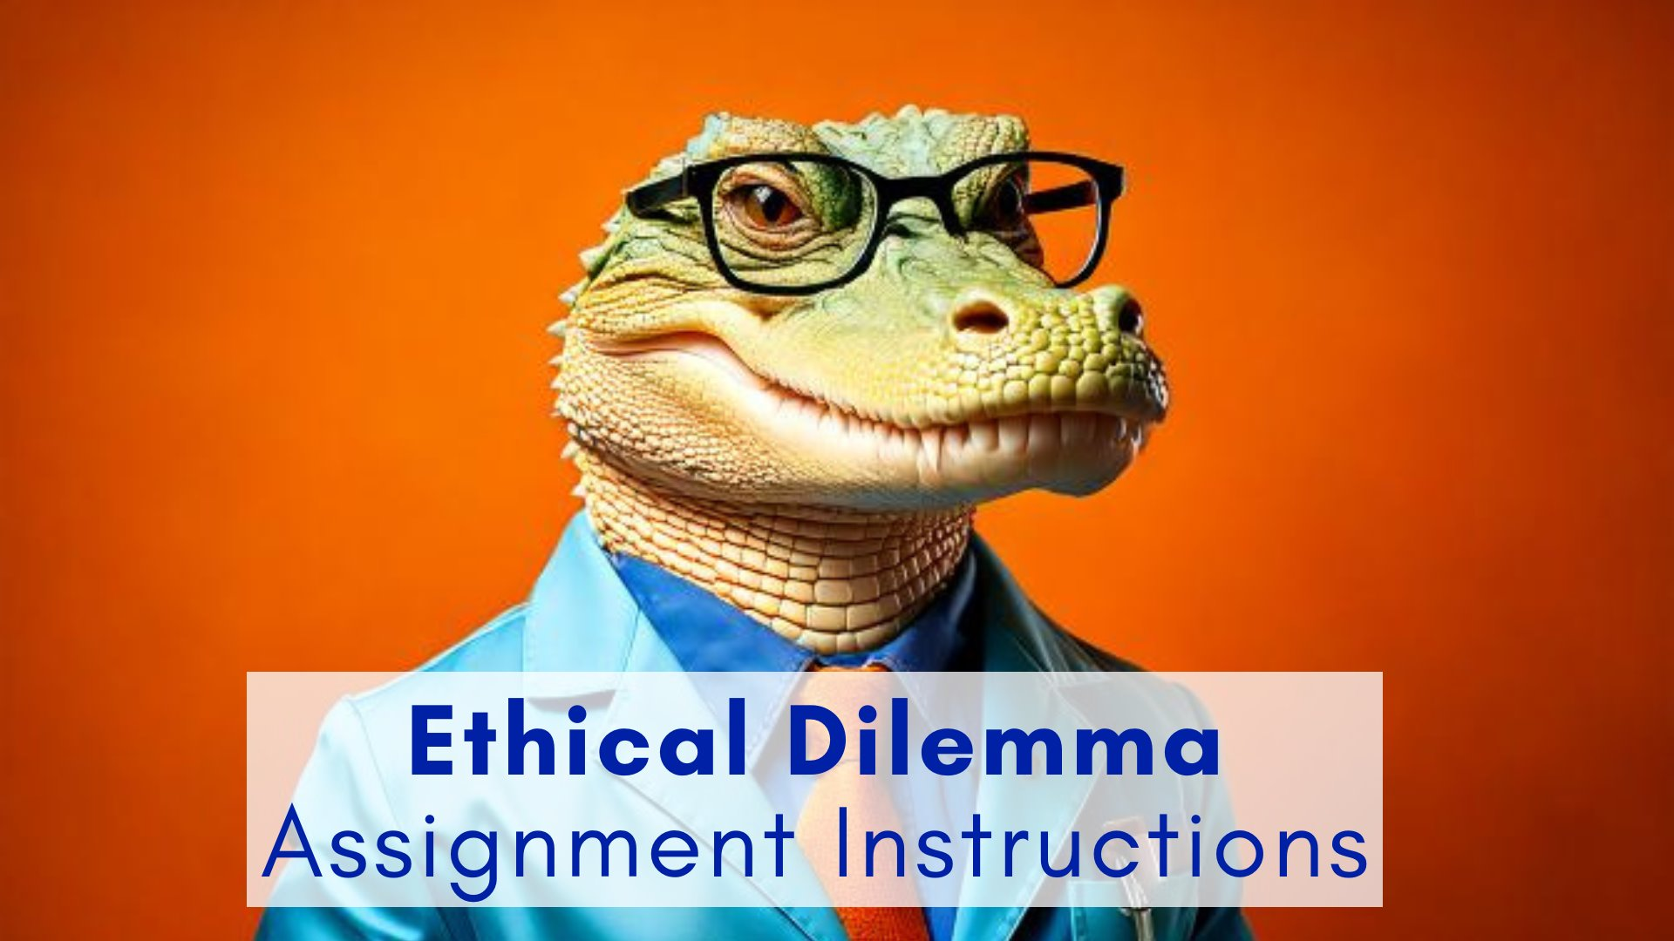
Role of AI: Directions
Maintained 2024 written project description & directions to use with 2025 students for consistency
Added specific steps to use NaviGator AI for interview
Created screenshare video to walk students through NaviGatorAI

Slide 8
Scoring Rubric
Identical rubric used in 2024 & 2025
Rubric measured domains:
Recognition of the Dilemma
Facts & Stakeholders
Ethical Principles & Core Values
Alternatives & Outcomes
Results & Reflection
Clarity & Organization
Four-point scale used, total of 24 points:
Excellent (4) - Acceptable (3) - Modification (2) - Unsatisfactory (1)

Slide 9
Statistical Analysis
The statistical analysis was performed using Stata v.17 (data software)
Non-parametric test (Mann-Whitney) was used to compare each category individually and the total scores with alpha = 0.05.

Slide 10
Faculty Participation
Method for creating stacks (Stack 1 & Stack 2)
Intra-examiner reliability
Inter- examiner agreement
Calibration activity
Scored two papers together (team of 4)
Scored two papers independently & compared
Scored stacks independently

Slide 11
Fellows: Survey Results
If you participated in both the 2024 and 2025 Ethics Day activities, did you notice a change in the quality of the Ethical Dilemma papers?
Responses | Percentage
The quality of papers improved. | 30%
the quality of papers declined. | 20%
I did not notice a change in the quality of papers. | 50%

Slide 12
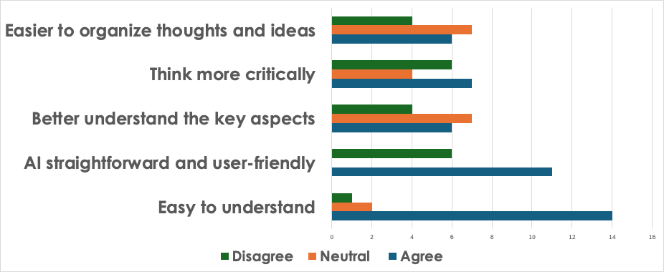
Students: Survey Results (part 1)

Slide 13
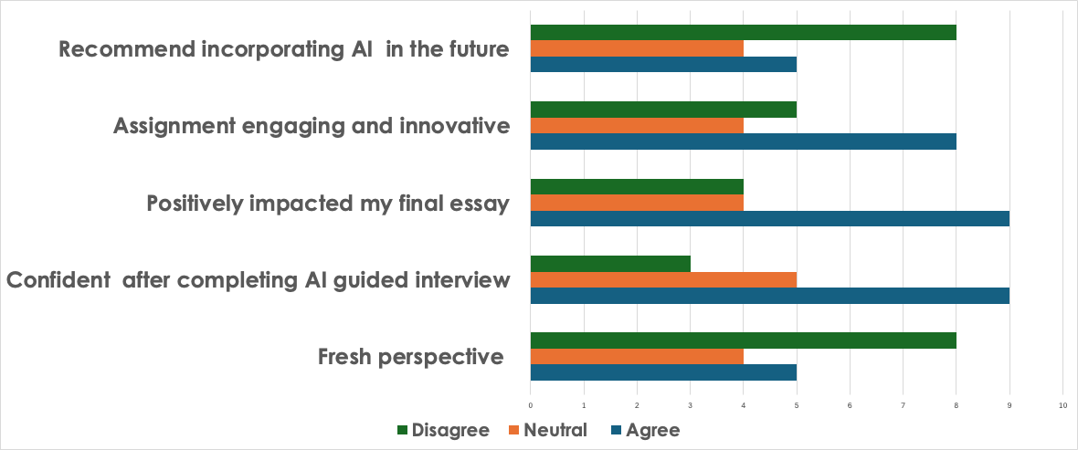
Students: Survey Results (part 2)

Slide 14
Comparison Using AI interviewer
 | Group 1 (c/o 2024) |  | Group 2 (c/o 2025)
 | Mean (SD) | Median (IQR) | Mean (SD) | Median (IQR)
Recognition | 2.90 (0.75)^{A} | 3 (2-3) | 2.79 (0.85)^{A} | 3 (2-3)
Facts/Stakeholders | 2.58 (0.68)^{A} | 3 (2-3) | 2.65 (0.73)^{A} | 3 (2-3)
Ethical Principles | 2.5 (0.82)^{A} | 2 (2-3) | 2.49 (0.92)^{A} | 2 (2-3)
Alternatives outcomes | 2.4 (0.73)^{A} | 2 (2-3) | 2.42 (.078)^{A} | 2 (2-3)
Results and Reflection | 2.34 (0.73)^{A} | 2 (2-3) | 2.28 (0.78)^{A} | 2 (2-3)
Clarity/Organization | 2.42 (0.61)^{A} | 2 (2-3) | 2.55 (.79)^{A} | 2 (2-3)
Total scores | 15.14 (3.36)^{A} | 14 (13-17) | 15.19 (3.79)^{A} | 14 (12-18)
Identical letter in the same row identifies no statistical difference among the groups (p>0.05)

Slide 15
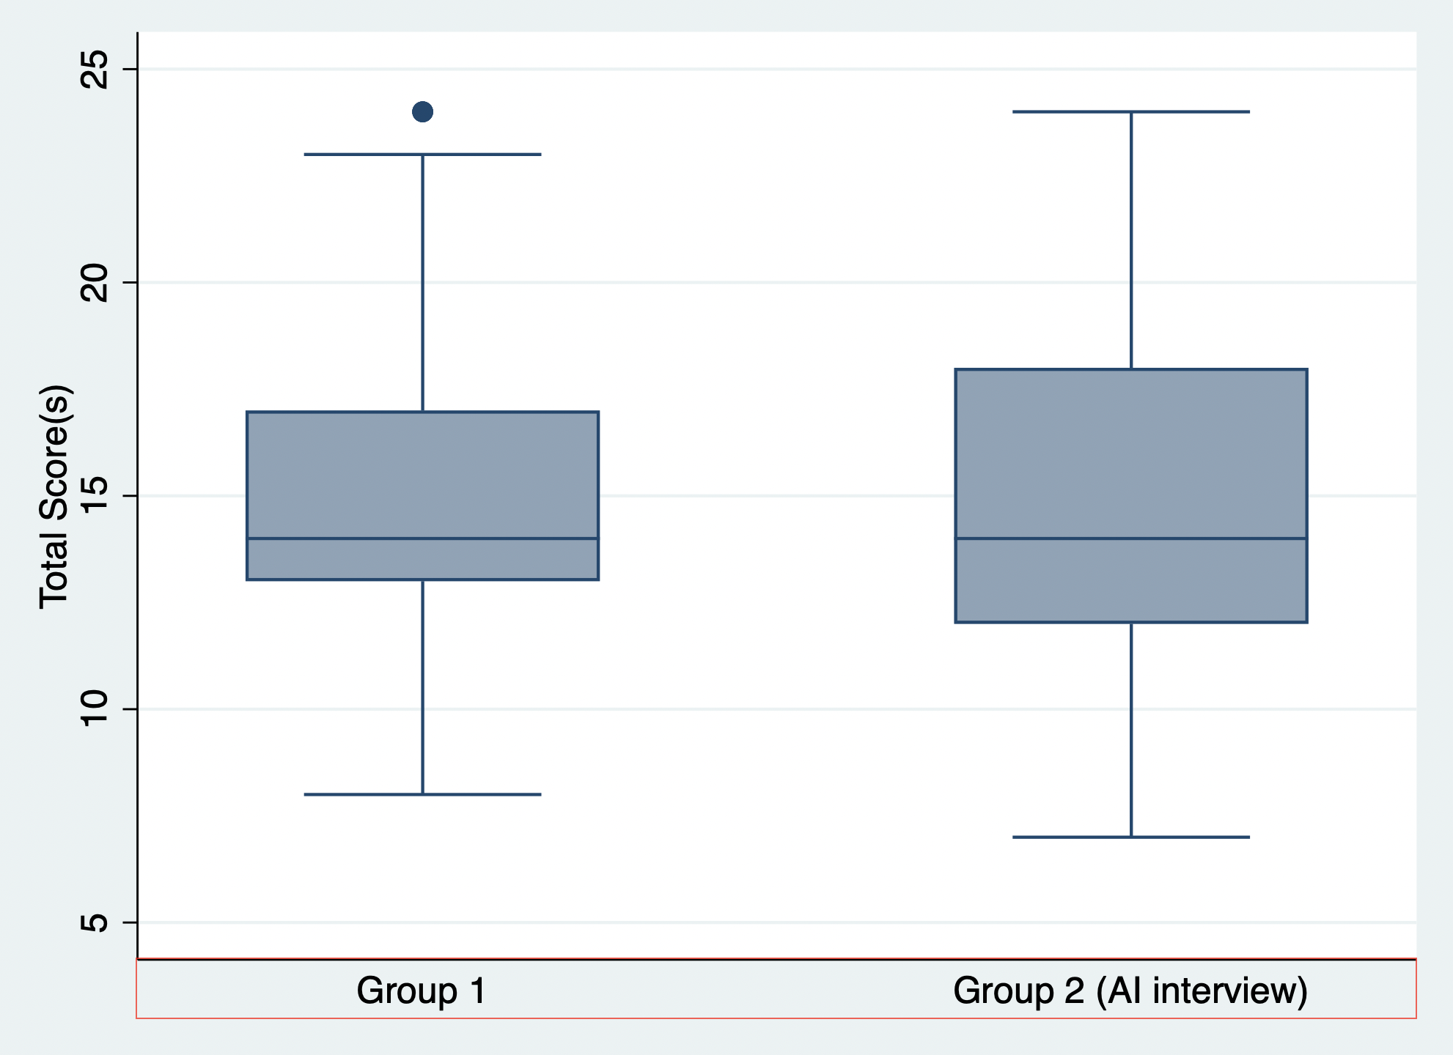
Comparison Using AI Interviewer

Slide 16
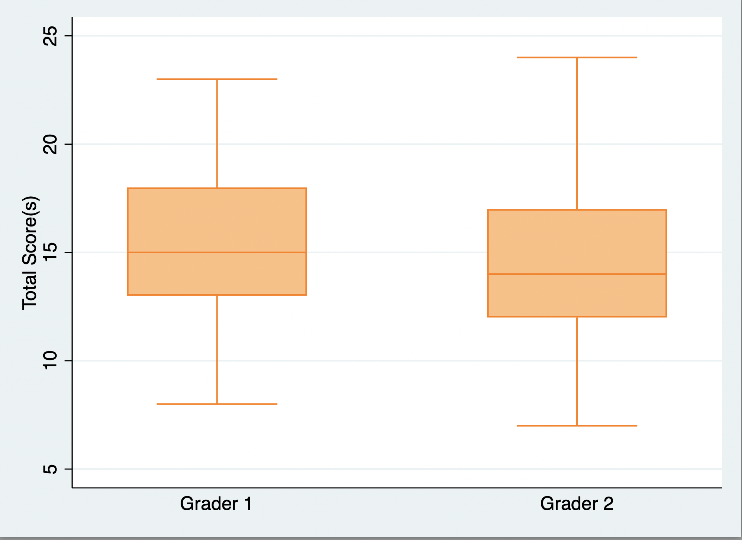
Comparison Using AI interviewer
The inter-examiner kappa showed an agreement of 63% and value of 0.35 (fair agreement)
The intra-examiners kappa showed agreements of 81.5% & 77.1% with values of 0.56 & 0.62 (substantial agreement)
We also confirmed that there was no difference among the scores between the graders.

Slide 17
Conclusion
AI needs to be infused into every component of an assignment to not feel "forced":
Learning outcomes
Description/instructions
Student activities
Final project/exam
Rubric
Positive learning: AI interview process required students to share genuine situation they faced (no 'cheating')

Slide 18
Future Updates to Ethical Dilemma Assignment
Provide students clear rationale for using AI
Define key terms like "ethical dilemma" and "core value"
Create rubric better aligned to Student Learning Outcomes
Provide high-quality sample student interview & paper to students
Provide faculty scorers with written directions during calibration activity
Create a framework to consistently re-envision, revise, & rebuild assignments & assessments with the support of AI

Slide 19
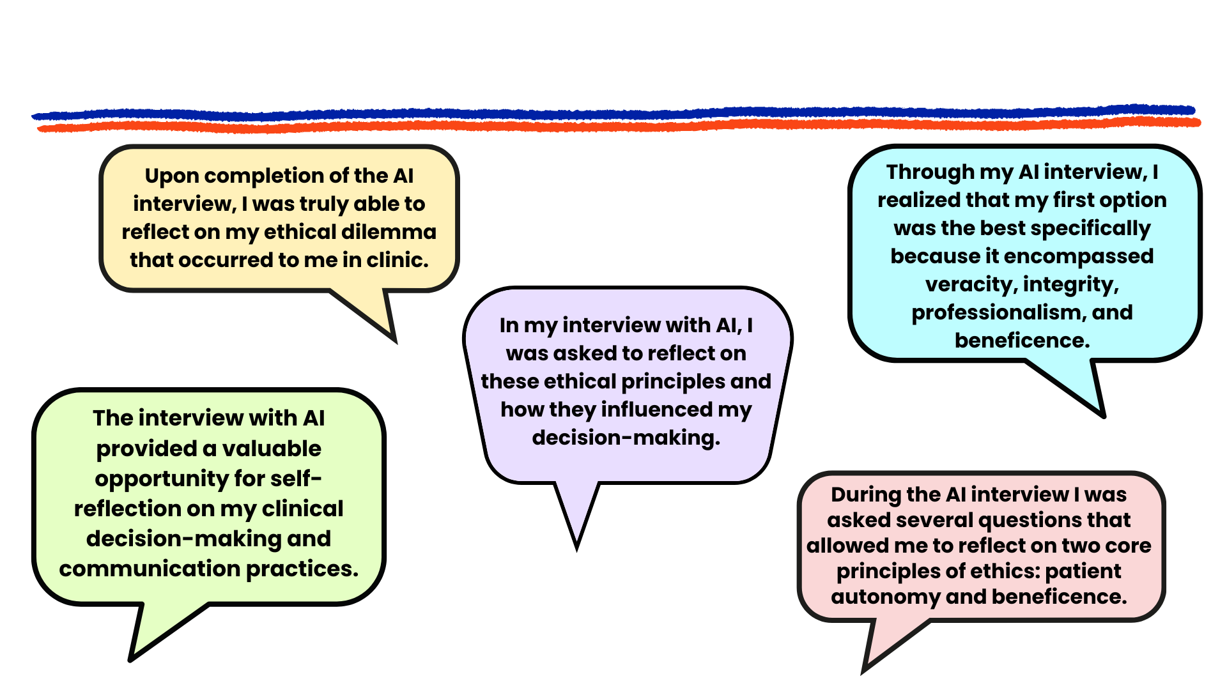
Student Testimonials

Slide 20
Final Thoughts
"...deep learning and inventiveness can come from playing with new toys, new concepts, new ideas, exploring them, tinkering with them, connecting them, and of course failing as well."
(Productive Failure, Manu Kapur)

