Slide 1


Value of Student Life Data in Predicting Retention
Ellu Li & Shaun Boren

Slide 2

Student Life
  Lifelong Wellbeing
  Career Design
  Community Connections
Notes:
Lifelong Wellbeing
RecSports
Counseling
Disability Resource Center
Career Design
Career Connections Center
Leadership & Service
MFOS
Community Connections
Student Activities
Greek Life
Housing

Slide 3
Our Research

Slide 4
Our Research
  Predictors
  Prediction
  Analysis
  Results
  Application

Slide 5
Predictors
  Identity
    E.g. gender, ethnicity, first gen
  Academic
    E.g. major, credit hours, term GPA
  Student Life
    E.g. Greek, Housing, RecSports

Slide 6
Prediction
  Retention
    First-year students
    Fall to fall enrollment

Slide 7
Analysis
Aspect | Traditional Statistics | Machine Learning
Goal | Explain relationships between variables (inference) | Maximize prediction accuracy (performance)
Focus | Understanding the effect of variables (e.g., β coefficients, p-values) | Making accurate predictions (metrics like accuracy, AUC)
Assumptions | Strong (e.g., linearity, normality) | Fewer assumptions, more flexibility
Interpretation | Emphasizes coefficients and confidence intervals | Emphasizes performance metrics and feature importance

Slide 8
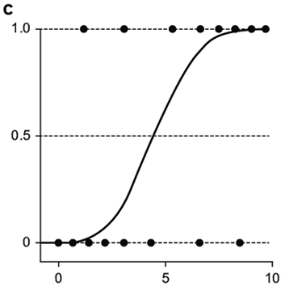
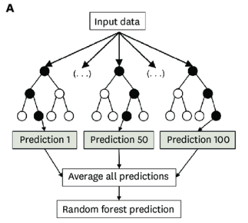
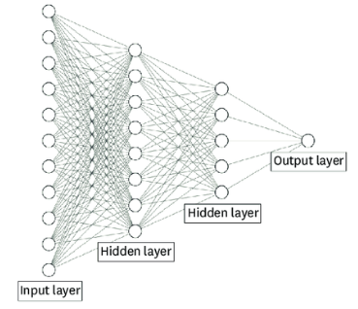
Analysis
  Logistic Regression
  Random Forest
  Artificial Neural Network
Notes:
Choo YJ, Chang MC. Use of Machine Learning in Stroke Rehabilitation: A Narrative Review. Brain Neurorehabil. 2022 Oct;15(3):e26. https://doi.org/10.12786/bn.2022.15.e26
Logistic regression – weights inputs to calculate probability of belonging to one of two groups.
Random forest – runs variations on multiple decision trees, averages the prediction from all trees.
Artificial Neural Network – mimics the human brain, layering units that learn patterns.

Slide 9
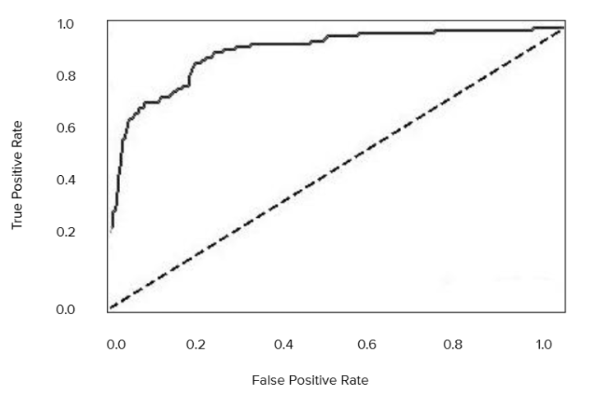
Analysis
  Area Under the Curve (AUC)
Notes:
AUC (Area Under the Curve): A measure of the model’s overall ability to distinguish between retained and non-retained students. AUC closer to 1 means better performance.
Plots true positive against false positive over various threshold settings.

Slide 10
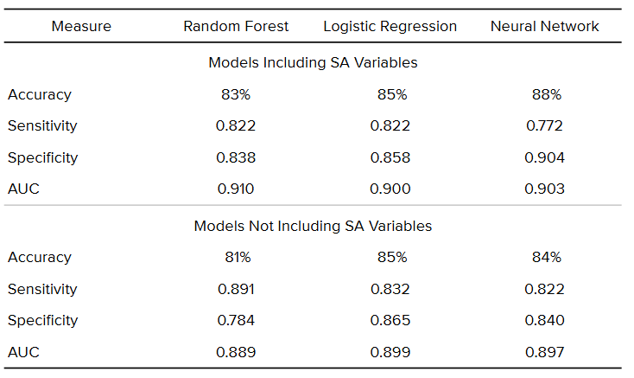
Results
Notes:
Accuracy: Overall percentage of correct predictions (retained or not retained).
Sensitivity : How well the model correctly identifies students who will not be retained.
Specificity : How well the model correctly identifies students who will be retained.

Slide 11
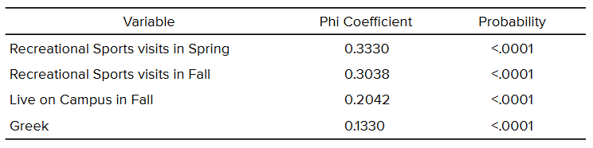
Results

Slide 12
Application
  Evidencing the Value of Student Life
  Contributing to Early Alert Systems
  Improving Response Efforts
  Incorporating More Data

Slide 13
Your Research

Slide 14
Your Research
  Connection to Student Life
  Predictors
  Gaps
  Application

Slide 15
Your Research - Connection to Student Life
  What concepts from Student Life apply to your areas?
    Community Connections
    Lifelong Wellbeing
    Career Design
  How do you define each?
  Examples from your areas.
  How it can/could be measured.
Notes:
Think/pair/share.

Slide 16
Your Research - Predictors
  What data from your areas do you think might contribute to predicting retention?
    Area
    Variable
      Name
      Definition
      Type (nominal, ordinal, ratio)
    Expected impact on model (positive-negative)
    Why it might matter
Notes:
Think/pair/share.

Slide 17
Your Research - Gaps
  What data related to student engagement are you not collecting that might be useful for predicting retention?
    Gap data
    How to collect
    How to automate
    Utility other than this model
Notes:
Think/pair/share.

Slide 18
Your Research - Application
  In what ways might you respond to predictions of student dropout?
    Outreach
    Intervention
      Passive
      Active
Notes:
Think/pair/share.

Slide 19
ANSWERS?

