Slide 1
From Principles to Literacy Standards
Preparing Music Teachers for Assessment in an Age of Accountability
Timothy S. Brophy
Professor, Music Education, and Director of Institutional Assessment
University of Florida
2019 SMTE Symposium, UNC-Greensboro
September 13, 2019

Slide 2
Today’s Goals
Present the context for this work
1
Present and discuss the principles
2
Present and discuss the developing standards
3
Share initial thoughts on a curriculum framework for incorporating the standards
4

Slide 3
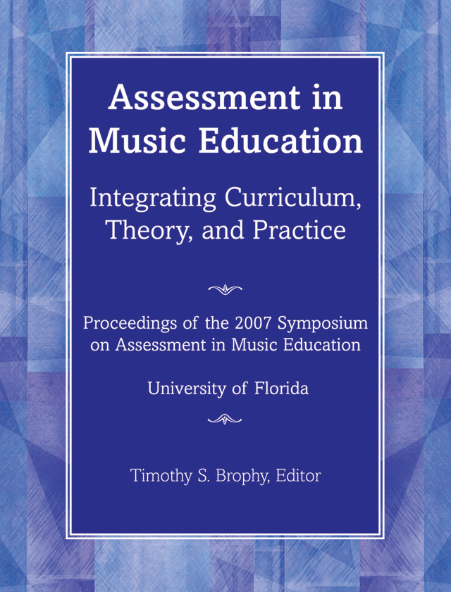
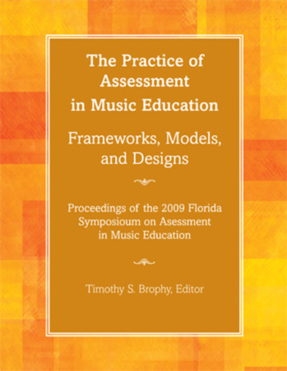
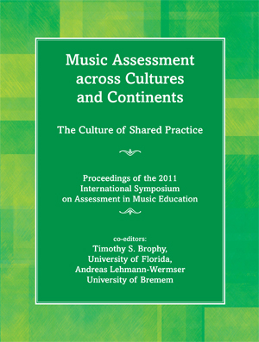
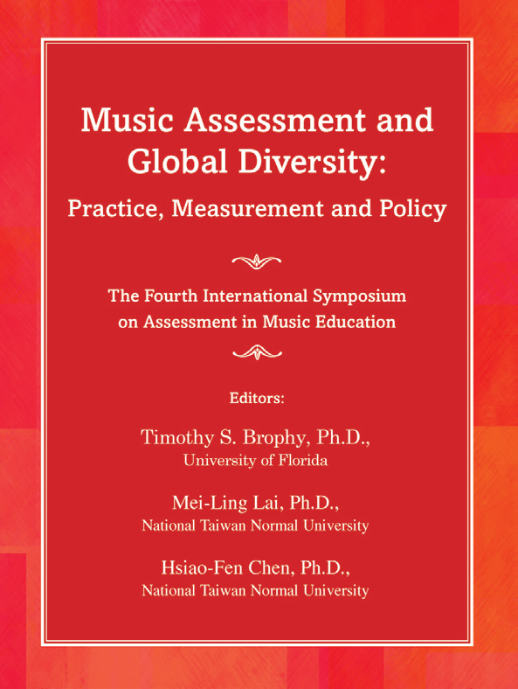
ISAME
Seven International Symposia on Assessment in Music Education from 2007-2019

Slide 4
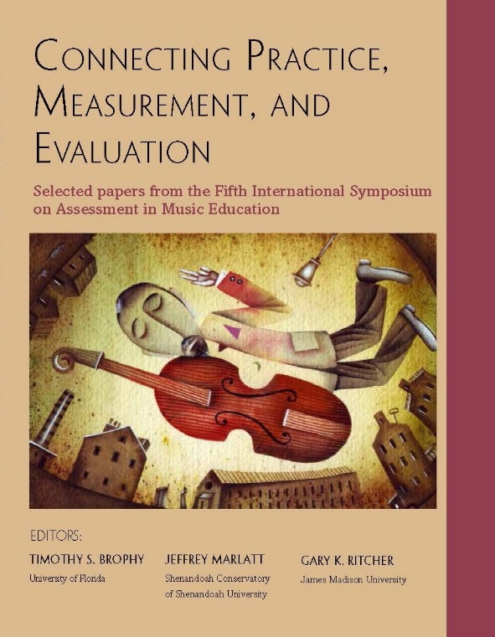
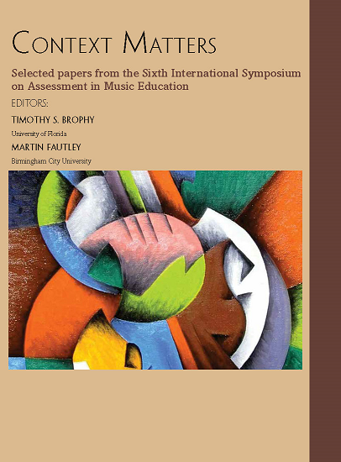
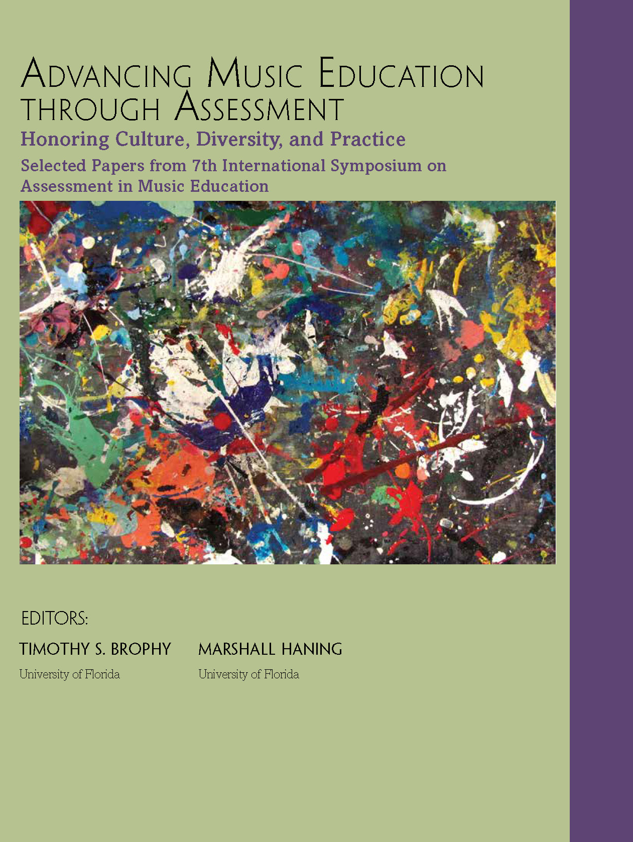
ISAME
Seven International Symposia on Assessment in Music Education from 2007-2019

Slide 5
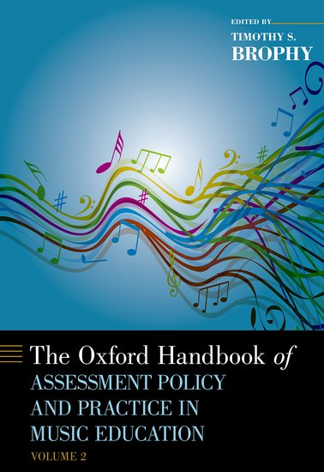
The Handbooks
Two volumes
75 chapters, 95 authors
January 2019
The Principles are in Volume 2, closing chapter

Slide 6
The Genesis of the International Principles
A review of the College Board’s Research on International Arts Standards (2013) and the International Perspectives chapters from the Oxford Handbook on Assessment Policy and Practice in Music Education (2019) revealed that:
Certain components of assessments are mentioned frequently as necessary:
Assessments must be examined for validity and reliability
Assessment must take place through an authentic engagement with music
Assessments must address student learning within a given curriculum over time.
Assessments must directly measure specific learning goals or outcomes embedded in the curriculum.
Music assessments rely heavily on the professional judgment of teachers. Qualitative measures are most frequent; some quantitative measures exist but these are very limited.
Assessments must be appropriately contextualized to strengthen validity.
Assessment guidelines for teachers to use to develop their own assessments are rare at the national level.
Michigan is the only state with published assessment literacy standards for teachers.

Slide 7
Our Approach
ISAME6 – Context Matters, Birmingham, UK
Martin Fautley (UK) and I developed and presented these to the delegates
These were discussed by a panel in the plenary on the second day: Marcia McCaffrey, USA; Dennis Wang, China; Leo Borne, Brazil; Kelly Parkes, USA; Karabo Mogane, South Africa; Glenn Nierman, USA
And, later the same day in the work sessions

Slide 8
The Principles
These are Grounded in the beliefs that:
all students are inherently musical,
assessment of music learning is best when it is ongoing and not episodic, and
assessment reflects the multidimensional nature of music learning
References:
Booth, N., Kuppan, G., Longtin, J., & Nenadic, E. (2018). Assessing the international principles of assessment in music education. In T. Brophy and M. Fautley (Eds.), Context matters: Selected papers from the 6th International Symposium on Assessment in Music Education (pp. 543-550).
Brophy, T. S. & Fautley, M. (2017, April 20). International principles for assessment in music education. Presented at Context matters: The 6th International Symposium on Assessment in Music Education. Birmingham City University, Birmingham, England. Unpublished manuscript.
Brophy, T. (2019). Assessment in music education: The state of the art. In T.S. Brophy (Ed.), The Oxford handbook of assessment policy and practice in music education (Vol. 2) (pp. 903-932). New York, NY: Oxford University Press.

Slide 9
The Principles
Principle of Shared Language. Assessment in music education should be discussed using commonly accepted definitions of assessment, measurement, and evaluation.
Principle of Quality. Assessments developed for music education must adhere to internationally accepted norms for validity, reliability, and fairness, and focus on student learning.

Slide 10
The Principles
Principle of Alignment. Assessments must arise from the curriculum for which they are developed and in which they are operationalized.
Principle of Authenticity. Assessment in music education must be authentic and appropriate for the context in which it is administered.

Slide 11
The Principles
Principle of Purpose. Assessments in music education must have a clear purpose, identify who is being assessed, and define clearly how the results will be used to improve student music learning.
Principle of Operability. Methods used in music education assessment must be clear, simple to understand, and easy to implement and use.

Slide 12
The Principles
Principle of Social Justice. Music curriculum and its associated assessment must be made available to and appropriately adapted for all students.
Principle of Valuing. Assessment should be valued as a means to improve student music learning and guide instruction.

Slide 13
ISAME7 – 2019: The Developing Standards
Reference:
Kastner, A.; Shultz, E; Lloyd, M. (in press). The development of assessment literacy standards for music teachers. In T. Brophy and M. Haning (Eds.), Advancing music education through assessment: Honoring culture, diversity, and practice. Chicago, IL: GIA.

Slide 14
An Imperative for the profession
“We must increase the assessment literacy of teachers. Preservice teacher programs should prepare teachers for classroom assessment; arts education program accreditation standards should include specific requirements for such training; and graduate programs that specialize in measurement in the arts are needed.” (p. 210)
Reference:
Shuler, S.C.; Brophy, T. S.; Sabol, F.R.; McGreevy-Nichols, S.; & Schuttler, M.J. (2016). Arts assessment in an age of accountability: Challenges and opportunities in implementation, design, and measurement. In H. Braun (Ed.), Meeting the challenges of measurement in and era of accountability (pp. 183-216). New York, NY: Routledge.

Slide 15
Assessment Literacy Standards Development
Dispositions – led by Kelly Parkes, USA, and Dennis Wang, China (UF doctoral student: Melissa A. Lloyd)
Knowledge – led by Glenn Nierman, USA, and Andreas Lehmann-Wermser, Germany (UF doctoral student: Elizabeth S. Schultz)
Skills/Performance – led by Fred Burrack, USA, and Tim Brophy, USA (UF doctoral student: Amanda Kastner)
Reference: Michigan Assessment Consortium. (2017). Assessment Literacy Standards. Mason, MI: Michigan Assessment Consortium.

Slide 16
INITIAL Work - Dispositions
Disposition identification is challenged by shared language for assessment
Students’ past experiences with assessment (in their nation’s educational system) will likely shape the ways they perceive assessment and how they formulate beliefs toward assessment in their future music classrooms
The biggest challenge: It is difficult to establish common beliefs toward assessment in music education when the expectations for assessment vary across cultures

Slide 17
Initial work - Knowledge
To assess music learning, music teachers must understand the connection among curricular objectives, learning objectives, and student learning
Teachers should know how to design assessments in a variety of modalities, including applications with technology, enables teachers to connect assessment to learning objectives in creative ways.
In order to develop high quality standards for long-time use, teachers should be aware of the best methodologies of assessments for learning, how to implement those assessment practices, and why particular assessment tools are effective in assessing student understanding

Slide 18
Initial Work – Skills/ Performance
TEACHERS WHO ARE ASSESSMENT-LITERATE ARE ABLE TO:
Develop student learning outcomes that align with the music content, skills, setting, and student population. When appropriate, these should align with state and national standards.
The outcomes identify the behaviors that represent music learning.
Select a variety of tasks for music assessment that are appropriate to content, purpose, and learning context.
Structure the learning environment to provide opportunities for assessment.
Enable students to self- and peer-assess.
Select, adapt, and/or develop quality measures appropriate to the music assessment context.

Slide 19
Initial Work – Skills/ Performance
TEACHERS WHO ARE ASSESSMENT-LITERATE ARE ABLE TO:
Hear, analyze, and provide feedback in real time music performance.
Articulate and document what students have learned in music through multiple measures.
Use assessment data to modify and improve music instruction and student learning.
Translate music assessment data appropriately for communication with various stakeholder groups (e.g., students, parents, administrators).

Slide 20
Next Steps
ISAME8, March 16-19, 2021, Hannover University of Music, Drama, and Media, Hannover, Germany

Slide 21
How do we prepare Music teachers for an age of accountability?
Standards development continues at ISAME8 in 2021
Guiding questions:
Can we resolve our definitional differences?
Are International Standards valuable?

Slide 22
How do we prepare Music teachers for an age of accountability?
Framework Development
Central questions for the profession:
Should assessment be taught as a discrete course, or embedded throughout the curriculum?
How would this be embedded across the curriculum to maximize preservice music teachers’ preparation for their careers?
What role does/will technology play in the future ot music learning assessment?
To what extent are music teacher educators responsible for modeling assessment knowledge, skills, practices, and dispositions? How much influence do we have?

Slide 23
MAPPING ASSESSMENT Standards ACROSS THE MUSIC TEACHER EDUCATION CURRICULUM
DRAFT: Assessment Development across the MTE Curriculum
Courses | Knowledge | Skills/Performance | Dispositions
Introductory Course(s) | M,I | M,I | O
Instrumental Skills | M, R | M, R | O
Theory/History | M, R | R | O
Methods | M, R, A | M, R,A | O,A
Student Teaching | A | A | O,A
M = Model
I = Introduce
R = Reinforce
A = Assess/Apply
O = observe/develop

Slide 24
A New Development: What are the implications for music teacher education?
“Funding for NAEP has remained flat, but the costs of building and administering quality assessments have not. The Governing Board had to make tradeoffs to maximize the value of NAEP while maintaining the quality that characterizes the program. As a result, the Board determined to eliminate four subjects from NAEP’s schedule, including the Arts assessment. This decision is in no way a reflection of the tremendous value that arts education has in cultivating a rich and well-rounded educational experience for students. Rather, it reflects the necessity of making difficult decisions about what assessments the NAEP program can continue to maintain at scale moving forward.”
– Lisa Stooksberry, Deputy Executive Director, National Assessment Governing Board, personal communication, July 24, 2019
-National Assessment Governing Board (2019, July 24). Governing Board Updates NAEP Assessment Schedule. Retrieved from: https://www.nagb.gov/news-and-events/news-releases/2019/release-20190724-assessment-schedule.html

Slide 25
Discussion and questions

Slide 26
TWO MAJOR EVENTS in 2020-2021
World Alliance for Arts Education (WAAE) World Summit on Arts Assessment
October 26-29, 2020, University of Florida
8th International Symposium on Assessment in Music Education
ISAME8, March 16-19, 2021, Hannover, Germany – see you there!

Slide 27
THANK YOU!
Timothy S. Brophy
University of Florida
Office of the Provost
tbrophy@aa.ufl.edu
352-273-4476 (direct line)

