Slide 1
Fairness and Equity in Assessment Task Force
Initial Meeting – January 22, 2021
9am-10am - Virtual meeting - Zoom

Slide 2
Agenda
Greetings and Introductions
Website: https://assessment.aa.ufl.edu/
The Charge to the Task Force
Getting started: Presentations from the Chairs
The Groups: Guideline Development and Model Development
Next Steps

Slide 3
The Charge
The Task Force is charged with establishing a set of guidelines for UF faculty, instructors, staff, and administrators to help ensure fairness and equity in assessment in all contexts at the university. The guidelines must address fairness and equity in the entire assessment process, including development, opportunity to learn, administration, scoring, score interpretations, and the evaluation of the measurement properties of the assessment.

Slide 4
Task Force Responsibilities
Attend scheduled Task Force meetings.
Contribute expertise to the proceedings and the development of the guidelines and models.
Communicate Task Force progress to your unit when appropriate.

Slide 5
Definition
Fairness and equity in assessment refer to the process of measurement (e.g., through surveys, batteries, scales, rubrics, tests) such that the interpretations and uses of scores are based on the construct, indicator, or learning outcomes being measured and not the characteristics of the examinee (e.g., race, ethnicity, gender, or disability). Fairness and equity in assessment ensure that no examinees are disadvantaged based on these characteristics.

Slide 6
The Groups
Guideline Development Group
Work with David Miller and Teresa Mutahi to develop the guidelines and review the recommendations from the model development group, and where mutually agreeable, implement the recommendations to modify the guidelines.
Model Development Group
Work with Corinne Huggins-Manley to locate and develop models that operationalize the guidelines in various contexts; provide the guideline development group with modifications to increase their utility.

Slide 7
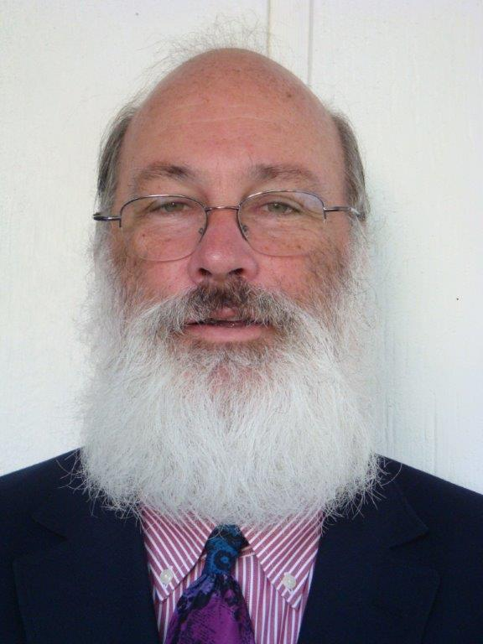
David Miller, Co-chair
Professor, Research Evaluation and Methodology
College of Education

Slide 8
Many Resources Available
Professional Standards
Books
Articles
Reports
Experiences

Slide 9
Professional Standards
Standards for Educational and Psychological Testing (2014). American Educational Research Association (AERA), American Psychological Association (APA), and National Council on Measurement in Education (NCME).
Code of Fair Testing Practices in Education(2004). Joint Committee on Testing Practices ( American Counseling Association, AERA, APA, American Speech-Language-Hearing Association, National Association of School Psychologists, National Association of Test Directors, and NCME.

Slide 10
Critical Areas of the Code of Fair Testing Practices in Education
Developing and Selecting Appropriate Tests
Administering and Scoring Tests
Reporting and Interpreting Test Results
Informing Test Takers

Slide 11
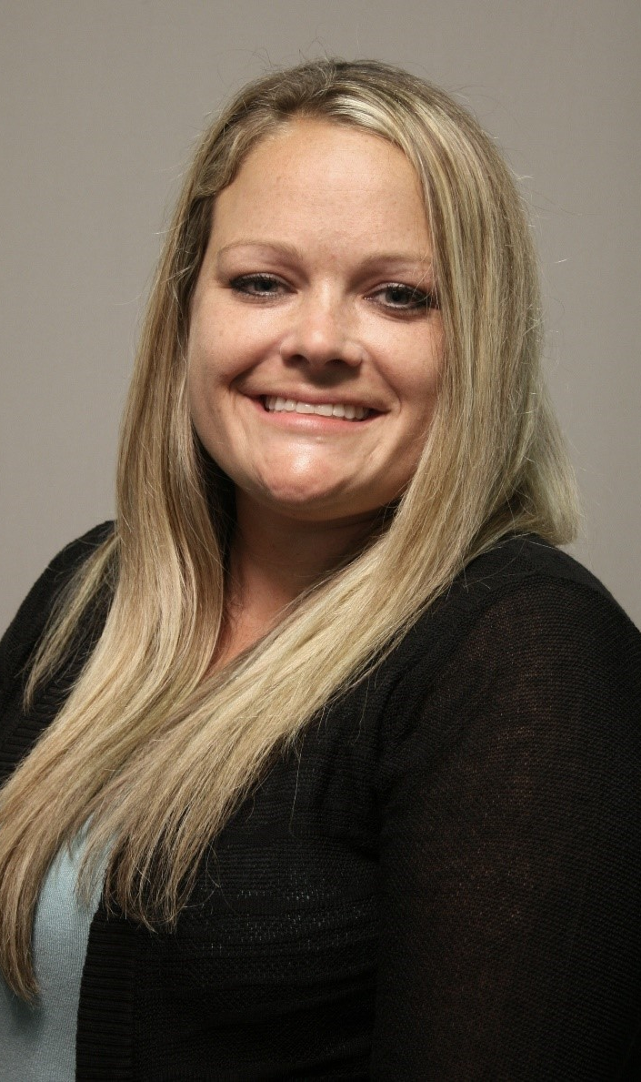
Corinne Huggins-Manley, Co-chair
Associate Professor, Research and Evaluation Methodology College of Education

Slide 12
Measurement Validity, Fairness, and Equity (In a Nutshell)

Slide 13
Validity as a Unified Concept
Definition: The degree to which evidence and theory support the interpretations of test scores entailed by proposed uses of tests.
(Standards for Educational and Psychological Testing, p. 9)
Validity is a matter of degree, not all or none
The test or instrument is not to be validated; the interpretations (and uses) are to be validated
Evidence of validity comes from multiple sources, but that does not mean that there are multiple types of validity
The central issue is appraisal of the meaning and consequences of measurement

Slide 15
Fairness and Equity in Assessment
Definition: The process of measurement (e.g., through surveys, batteries, scales, rubrics, tests) such that the interpretations and uses of scores are based on the construct, indicator, or learning outcomes being measured and not the characteristics of the examinee (e.g., race, ethnicity, gender, or disability). Fairness and equity in assessment ensure that no examinees are disadvantaged based on these characteristics.
(UF Fairness and Equity in Assessment Task Force, 2021)

Slide 16
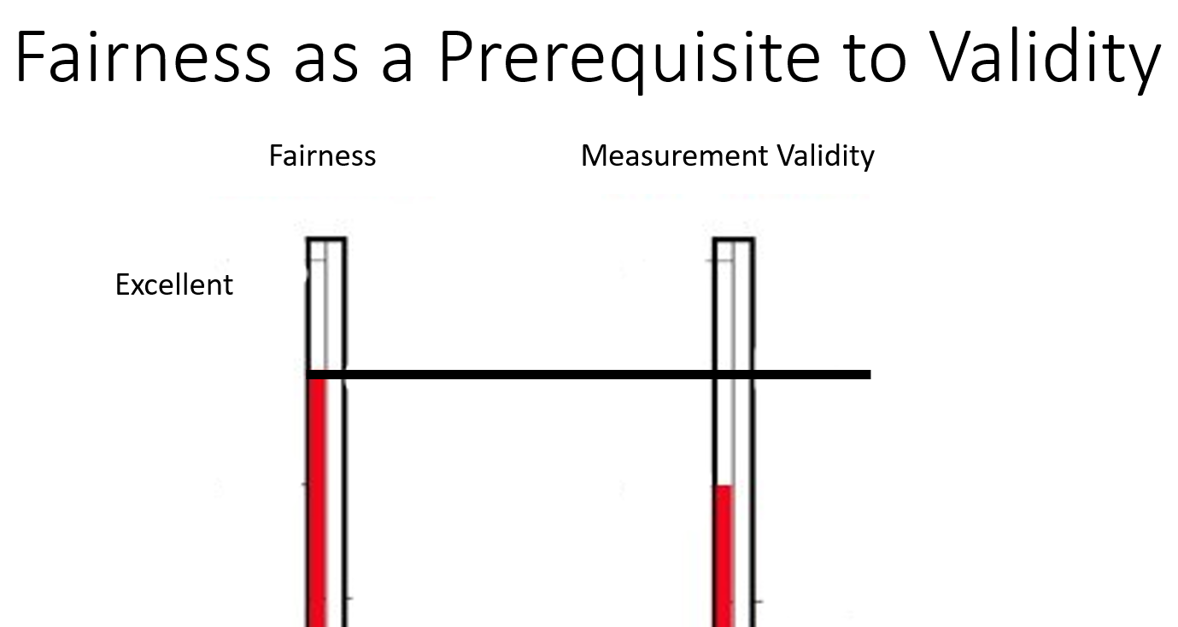

Slide 17
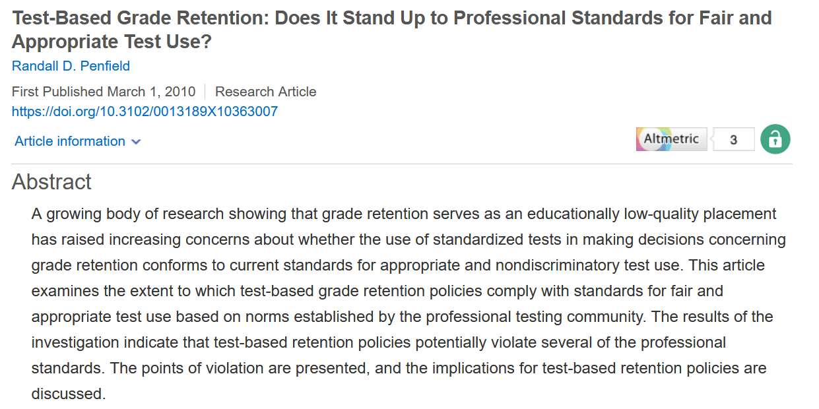
There are Many Examples of Evaluating Measurement Fairness

Slide 18
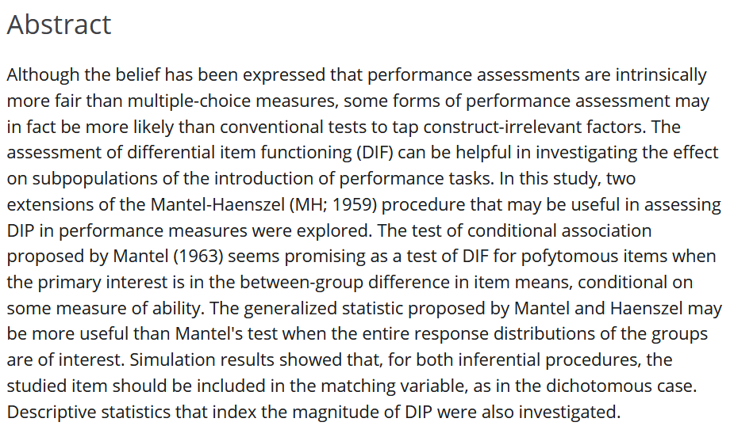
There are Many Examples of Evaluating Measurement Fairness

Slide 19
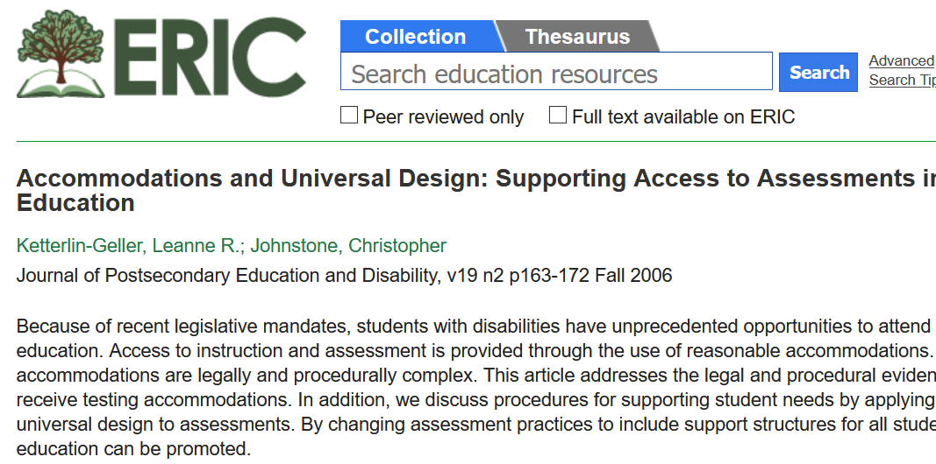
There are Many Examples of Evaluating Measurement Fairness

Slide 20
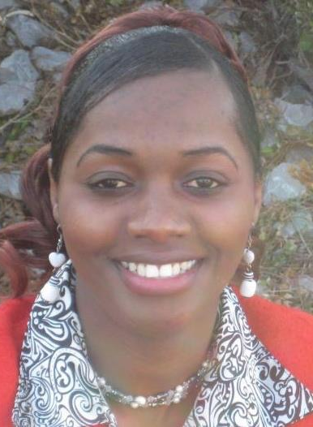
Teresa Mutahi, Co-chair
Senior Lecturer & Biology Major Undergraduate Coordinator

Slide 21
Status of Fairness and Equity in assessments at UF
Where are we?
What guidelines/policies exist?
Are there fairness and equity issues in assessments that we should address?
Are there strengths indicative of fairness and equity in assessments that could be replicated across UF?
Developing Assessment tools
Administering Assessments
Informing examinees
Reporting and Interpreting Scores
Use and Evaluation of Assessments

Slide 22
Examination of UF’s Status on Fairness & Equity in Assessments
Guidelines Development Group
Model Development Group
Faculty/College/Unit representatives
Student Representatives
Administrators/UFHR
Library
Graduate School
Division of Student Affairs Assessment and Research

Slide 23
Assessment tools
Systems
Are our assessment systems inclusive, fair and equitable for all faculty, staff and student populations?
Processes
Methods
“Methods that reflect inherent biases are also much less likely to be detected by assessment teams unless they include diverse faculty and staff” (Huston C., 2020)
Scrutinize UF’s Fairness & Equity Gaps/ Issues/Strengths

Slide 24
Scrutinize UF’s Fairness and Equity Gaps/ Issues/Strengths
Guidelines
Policies- individuals, programs & institution
Practices
Are our current assessment practices open and inclusive of faculty, staff or student populations? (Huston C., 2020).
Non-science faculty added the practice of student-centered assessment (peer assessment, competency-based grading, opportunity to submit multiple drafts) compared to exams while science faculty did not (Yanowitz & Hahs-Vaughn (2007).

Slide 25
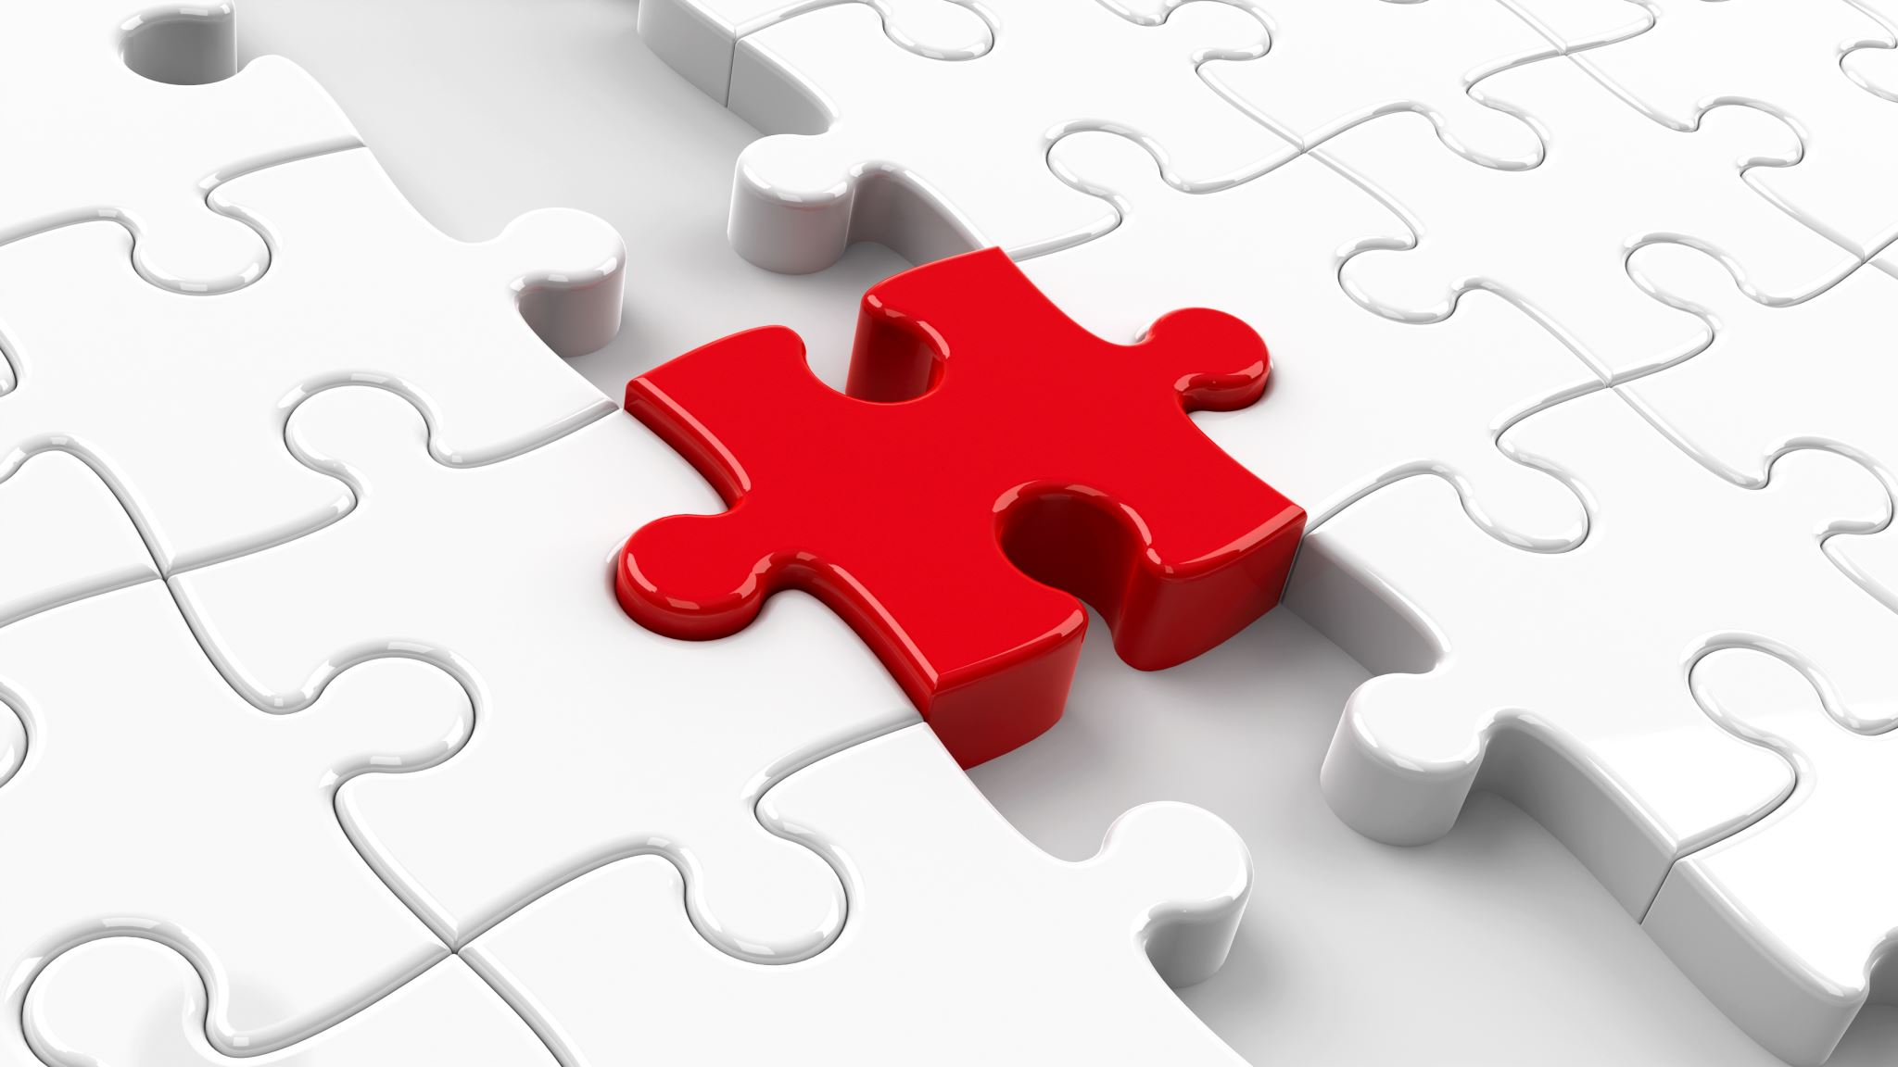
Status of Fairness and Equity in Assessments at UF
Practices
Experiences
Literature
Case Studies
Models
Identify Gaps/issues and strengths

Slide 26
Fairness & Equity Gaps/Issues & Strengths Survey
https://ufl.qualtrics.com/jfe/form/SV_9NBYvAYioRqqDSC

Slide 27
References
Huston, C. (2020).Strategies for Change: Equity in Assessment Practices. Urbana, IL: National Institute for Learning Outcomes Assessment, Council for the Advancement of Standards in Higher Education, and Campus Labs. Retrieved January 20th 2020 from http://www.learningoutcomesassessment.org/
Karen L. Yanowitz & Debbie L. Hahs-Vaughn (2007).Changes in student-centered assessment by postsecondary science and non-science faculty, Teaching in Higher Education, 12:2, 171-184, DOI: 10.1080/13562510701191927

Slide 28
Next Steps
You will receive the survey via email, please complete it and submit it as soon as possible
You will receive a doodle poll soon requesting your availability for bi-weekly meetings by group – we will ask you to identify times you are open
The chairs will contact you about the first meeting time and date as soon as all responses have been received and the day/time is set

Slide 29
Thank You!

